Slide 1
REACT.JS
INTRODUCTION
SHALOM MATHEW

Slide 2
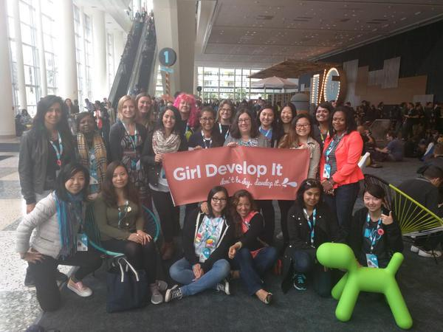

What is Girl Develop It?
GDI’s mission is to provide affordable, accessible, and supportive programs for women and non-binary adults to learn software through mentorship and hands-on instruction.

Slide 3

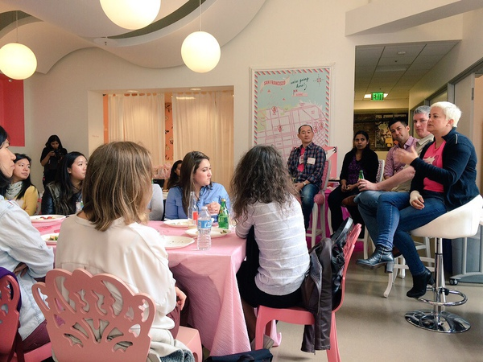
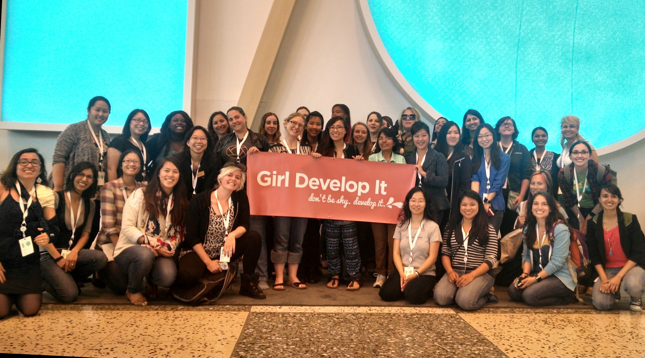
What does Girl Develop It offer?
Frontend web dev series on evenings and weekends, including HTML, CSS, JS
Special career building events like “Intro to Docker,” “Salary Negotiations,” and “Hacking the Tech Job Search”
Open Source Month, with GDI curriculum hacking
https://girldevelopit.com/events/#/list
Upcoming Events

Slide 4

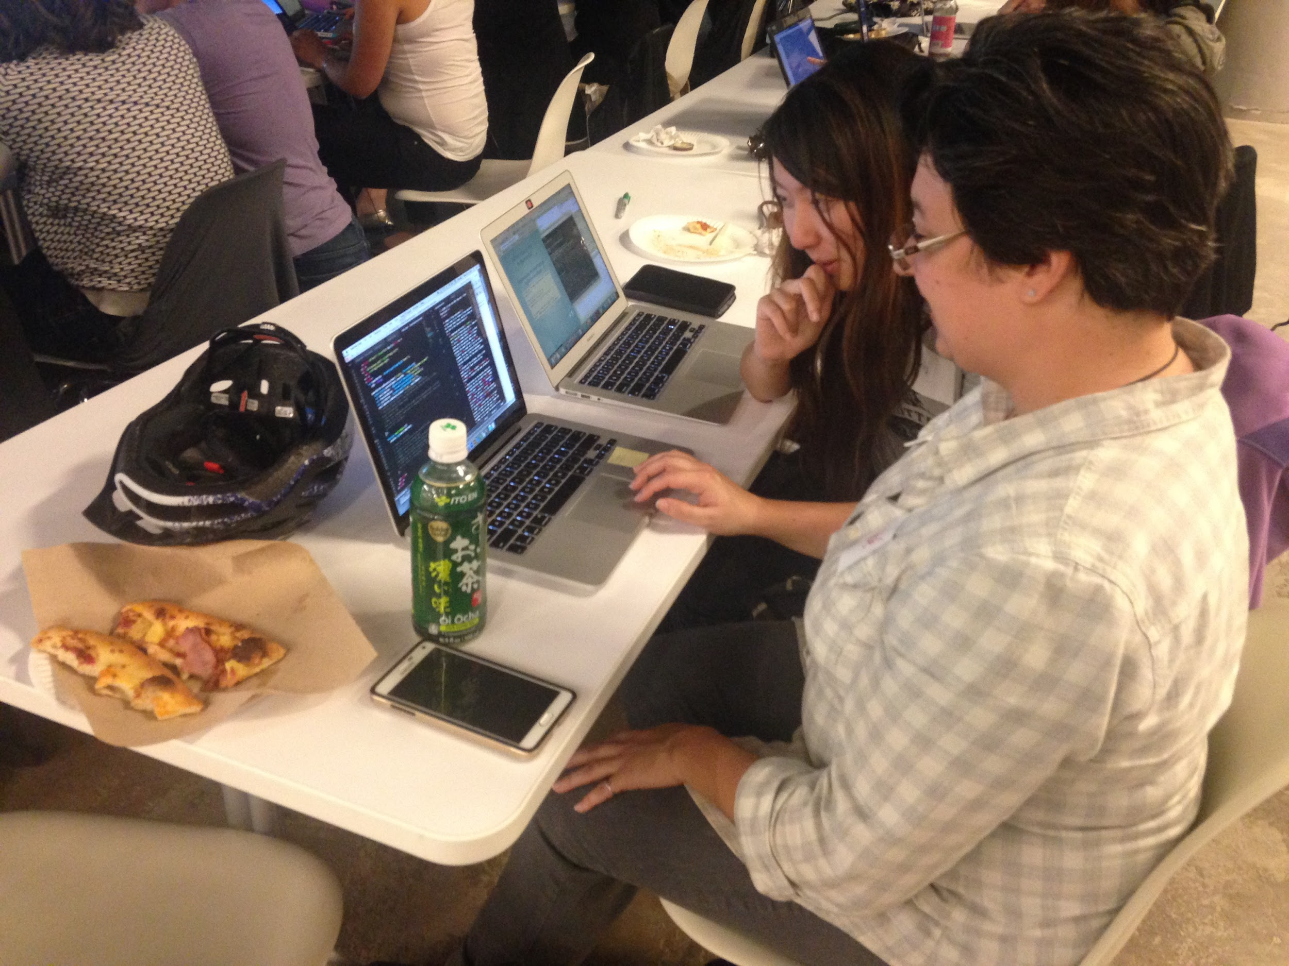
Classroom policies
Create a warm and welcoming environment:
Celebrate with your neighbor when something goes well!
Help them out if they need a hand!
Your focus is appreciated and helps your classmates focus.
There are no dumb questions. This is your opportunity to ask without judgment.
We have a code of conduct.

Slide 5
Overview
‣ Intros
‣ What is React? ‣ Setup
‣ Components in React ‣ Props
‣ State ‣ PreProject ‣ Start Catstagram Project

Slide 6

Why React?
What problems does React solve?
Why do you want to learn React?
When is React the “right” tool?

Slide 7
What is React?
Documentation is located at https://reactjs.org/docs/getting-started.html Need some clarification? Read the docs! Have some downtime in class? Read the docs!
Notes:
Hfnotes: 1) creates reusable UI easily (flexible) 2) only update parts of the page that need to be updated (SPA) (efficient)
3)

Slide 8
What is React?
According to Facebook, React is:
“... a declarative, efficient, and flexible JavaScript library for building user interfaces. ... Your components tell React what you want to render – then React will efficiently update and render just the right components when your data changes.”
Notes:
Hfnotes: 1) creates reusable UI easily (flexible) 2) only update parts of the page that need to be updated (SPA) (efficient)
3)

Slide 9
What is React?
According to Facebook, React is:
“... a declarative, efficient, and flexible JavaScript library for building user interfaces. ... Your components tell React what you want to render – then React will efficiently update and render just the right components when your data changes.”

Slide 10
What is React? - Declarative
Declarative
Describes what you want your page to look and feel like
Notes:
Should we introduce declarative vs. imperative or just leave it as what vs how?

Slide 11
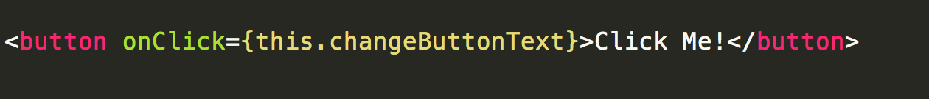
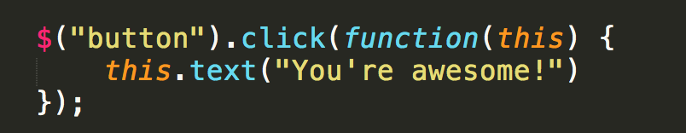
What is React? - Declarative
What:
On click, change the inner text of this button
How:
Create the button element in the HTML
Get the button element by id
Attach a click event listener
Pass in the function to be executed
Select the inner text of the button
Change the inner text
Also in a completely separate file than the HTML!
React
JQuery
Notes:
HTML itself is declarative though hnotes: write javascript/jquery and a write react and show the code difference and ask what is this code doing

Slide 12
What is React? - Efficient
React uses the virtual DOM
Internal representation of the rendered UI
Performs a “diff” between the previous and current states of the application
Only updates the DOM nodes that have changed
For your reading:
https://www.codecademy.com/articles/react-virtual-dom
Notes:
Hnotes: Need to explain the DOM? Also why is the virtual dom necessary?

Slide 13
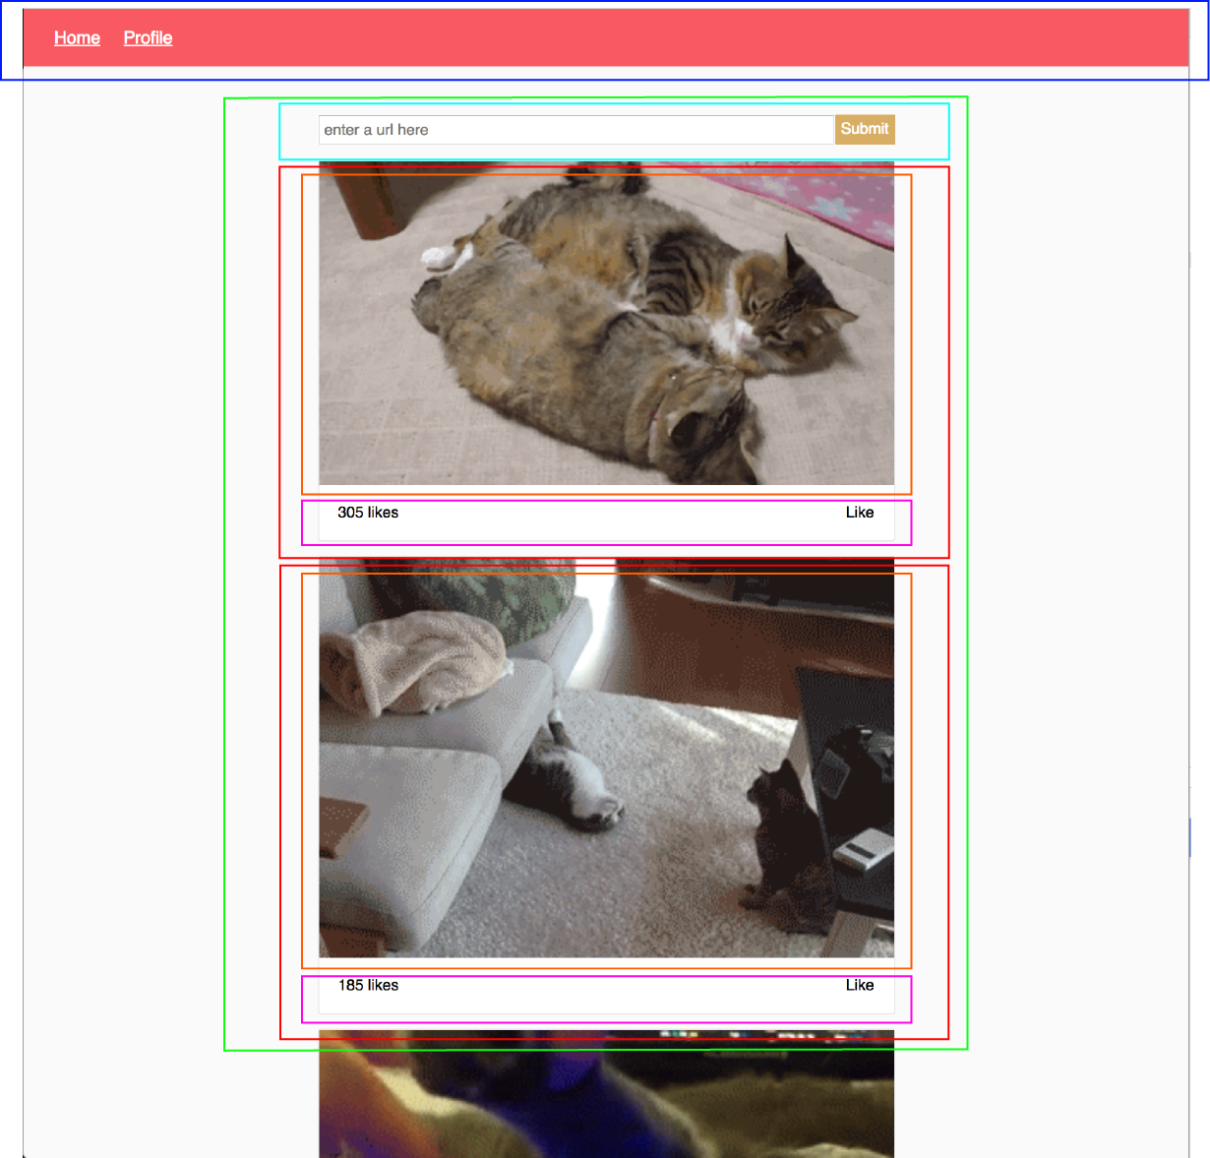
What is React? - Flexible
Library for building user interfaces
Provides the syntax and structure for breaking down a large UI into composable units
React is not a framework! There is:
No application architecture
No persistent state store
No data fetcher
Notes:
Your components tell React what you want to render Curriculum notes: what is a component? Composable units

Slide 14
What is React?
Key points:
React is component based
Larger UIs are subdivided into smaller units containing logic and rendering instructions
Data flow is unidirectional in React
Data is passed from parent to child
Notes:
Changes in the child do not affect the parent, but changes in the parent affect the child
Unidirectional data flow makes it easy to reason about our application
Hnotes: IMAGES

Slide 15
Predecessors/Alternatives
React is not the only front end library out there. There are many libraries/frameworks - jQuery, Angular, Vue, Backbone, Marionette, etc etc.
The biggest reasons to use React over others libraries are:
The virtual DOM is very fast
Component based code is easily reusable
Not a heavy view-model-controller framework - just a view
Both iOS and Android applications can be created with it
ReactJS provides support for both client-side and server-side
Huge open source ecosystem
Source: https://www.quora.com/What-are-the-advantages-of-React-over-other-JS-frameworks

Slide 16
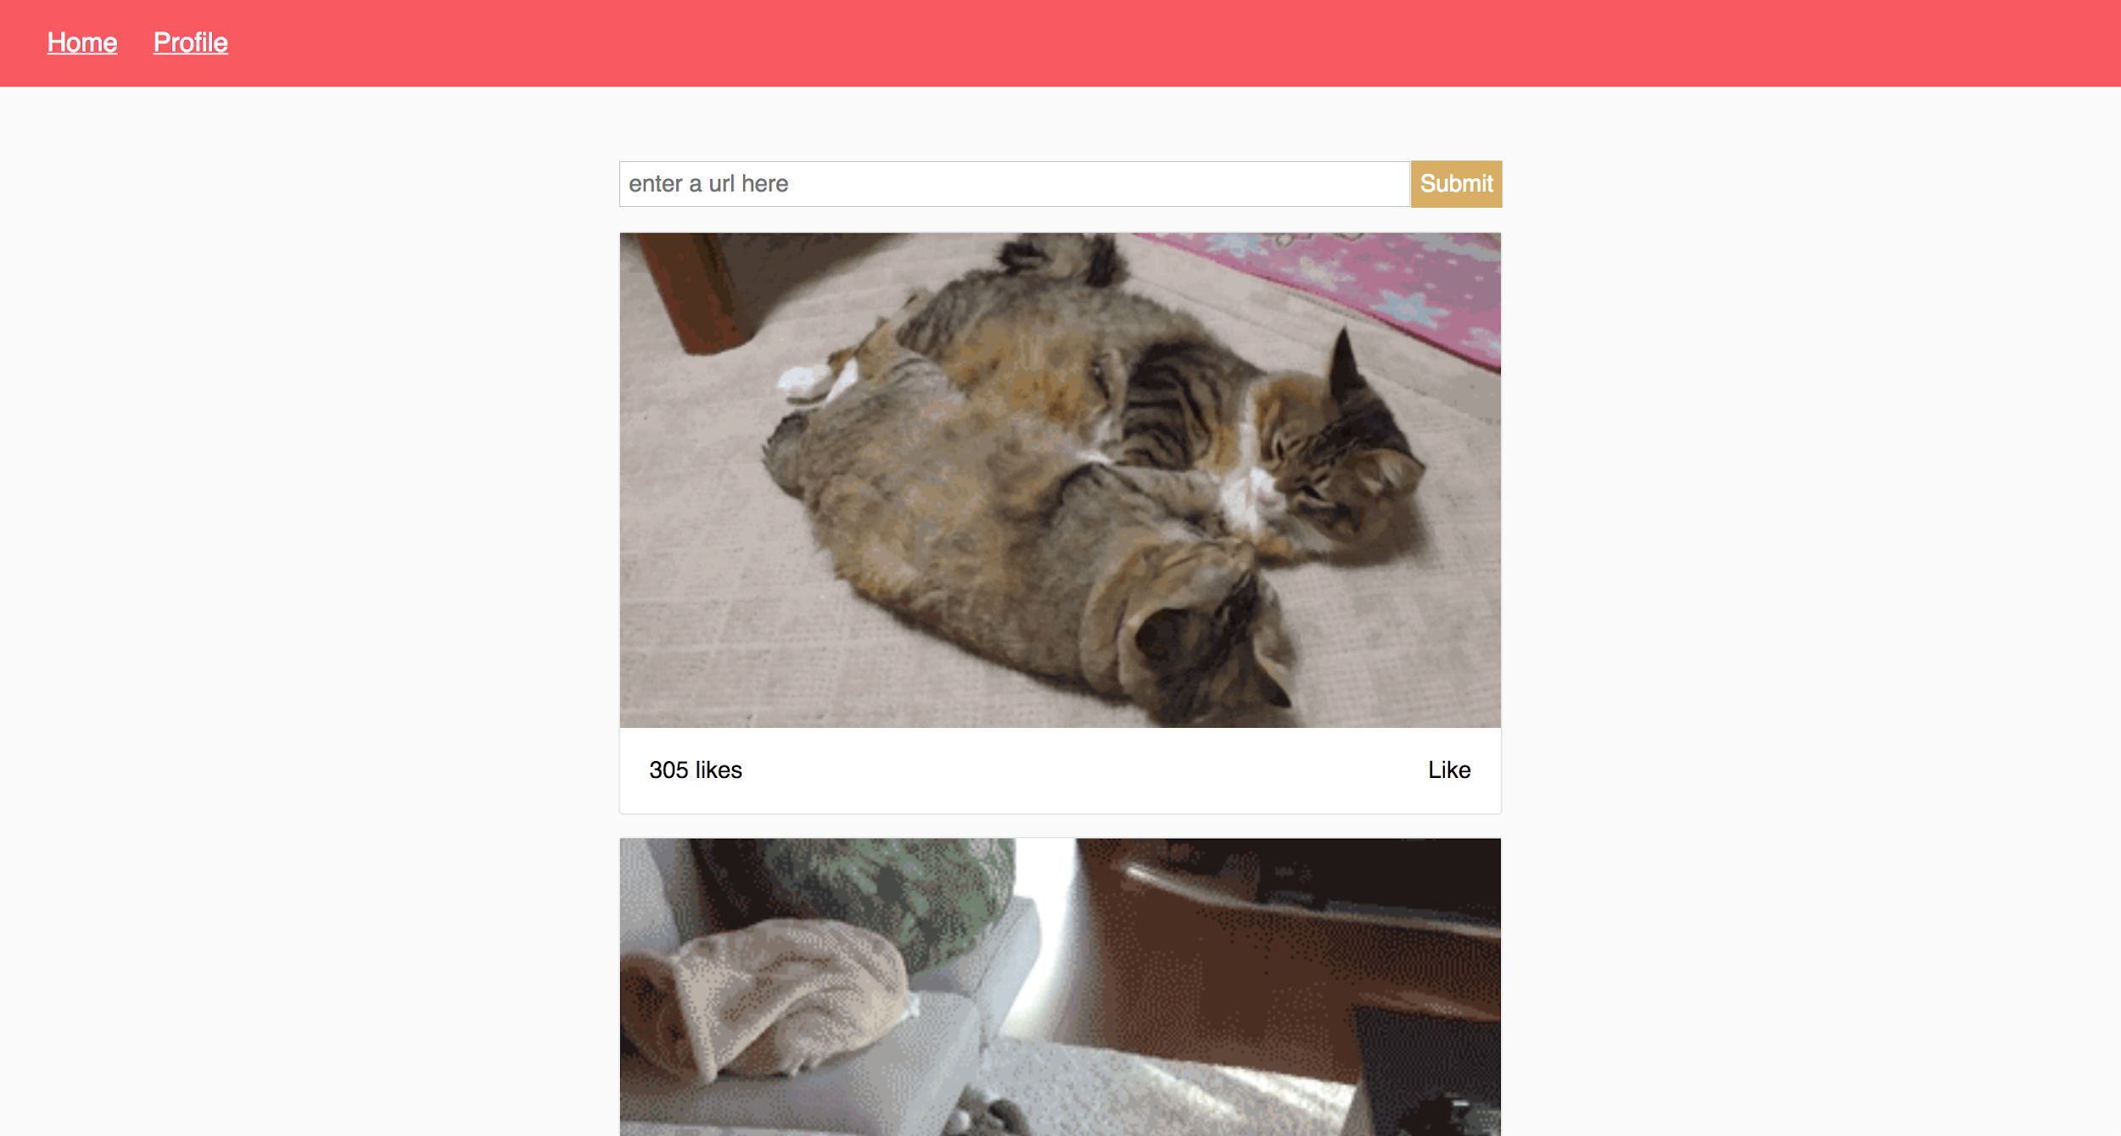
Catstagram - React.js style!
Here is the capstone we’ll be working on for two days(Project Week):

Slide 17
ES6

Slide 18
ES6 Review
Classes and Function subject slide
Notes:
Changes in the child do not affect the parent, but changes in the parent affect the child
Unidirectional data flow makes it easy to reason about our application
Hnotes: IMAGES

Slide 19
Setup

